Slide 1



Durham Shared-Fail2Ban
“Blocking ourselves and attackers since 2018”
Presented by Paul Clark
10th February 2021

Slide 2

What is Fail2ban
Brute Force prevention
Log Analysis using filters
Standard action – Firewall entry insertion
Highly customisable
Easy to install/maintain
Available across most distributions

Slide 3

Sharing is caring
Standard Fail2Ban client agent modified to perform the following:
Report to a centralised datastore
Retrieve unknown IP’s and pre-emptively initiate blocking
Escalate Jail time/punishment based on time/No. of instances*
* Currently requires manual implementation

Slide 4
System Goals
Reduce target area by banning at initial source and mitigating further attempts against remote systems.
Centralise Accounting to aid in data gathering/research.
Export gathered data into external resources.
Import data from external resources to allow automatic attack prevention prior to one occurring.

Slide 5
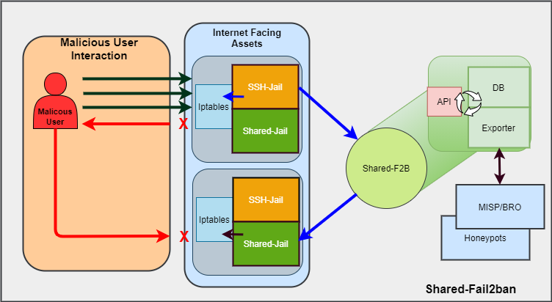
Basic Functionality

Slide 6
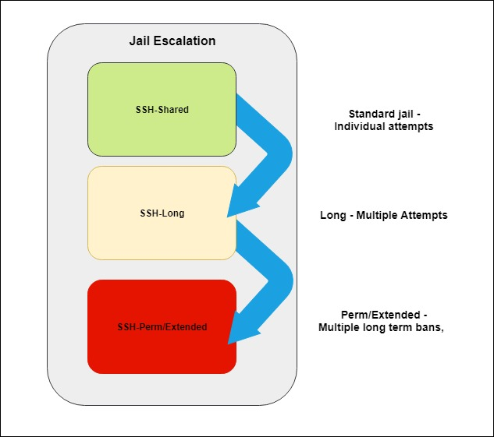
Escalation
Purpose:
Minimise extended bans for common user error
Persistent aggressive attempts banned for longer periods
Latest Version – Automated Incremental Banning

Slide 7
Semi-Production Deployments
IPPP, Durham University
GridPP at Durham University
Glasgow University

Slide 8

Current Status
Shared Fail2ban – API updated rollout to replace initial MySQL implementation
Centralized data store within Durham Infrastructure
Interest in broader implementation within local physics
Threat Data available to central IT
MISP Feed Integration
Bash and Python development files pushed to https://github.com/bulgemonkey/Shared-Fail2Ban

Slide 9
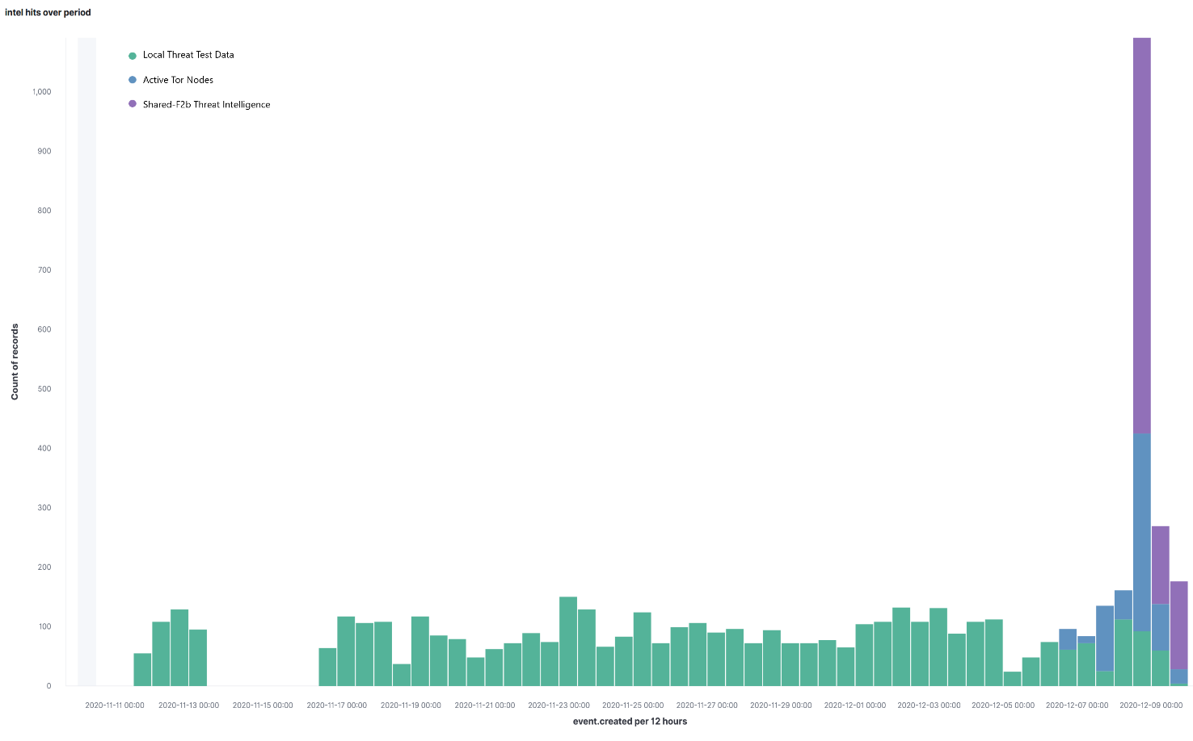
Shared-F2B, MISP and Zeek

Slide 10
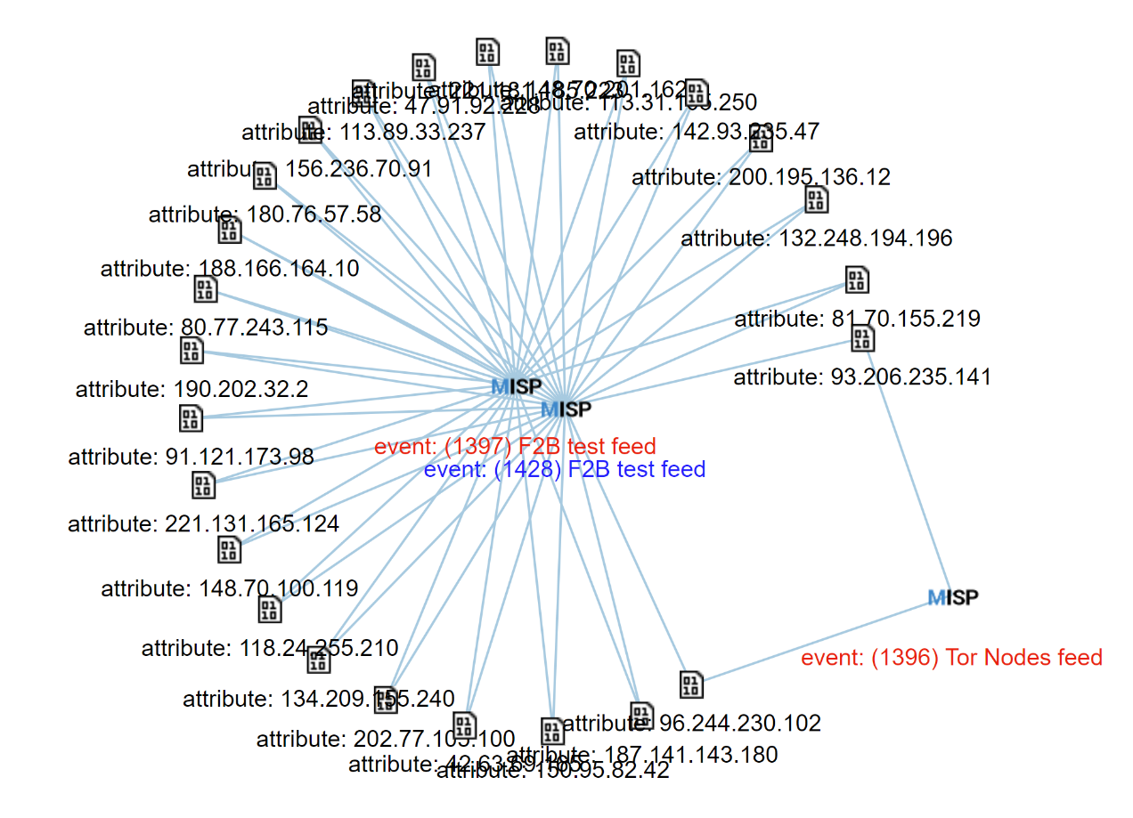
MISP - Event Correlation

Slide 11
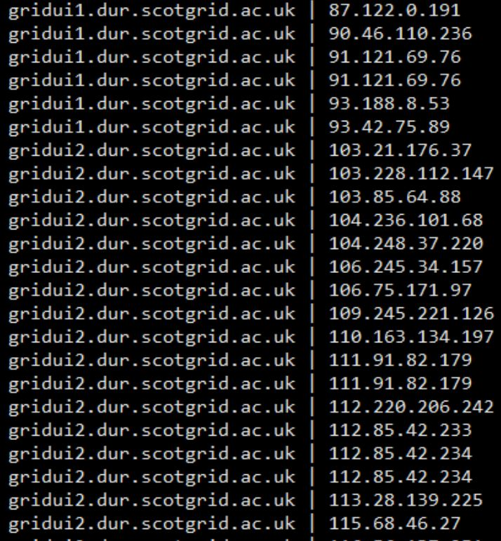
Traffic Highlights
Continuous attempts from:
221.181.185.29 – China
221.181.185.223 – China
221.181.185.143 – China
81.161.63.103 – Russia
https://monitoring.dur.scotgrid.ac.uk/f2b.php

Slide 12
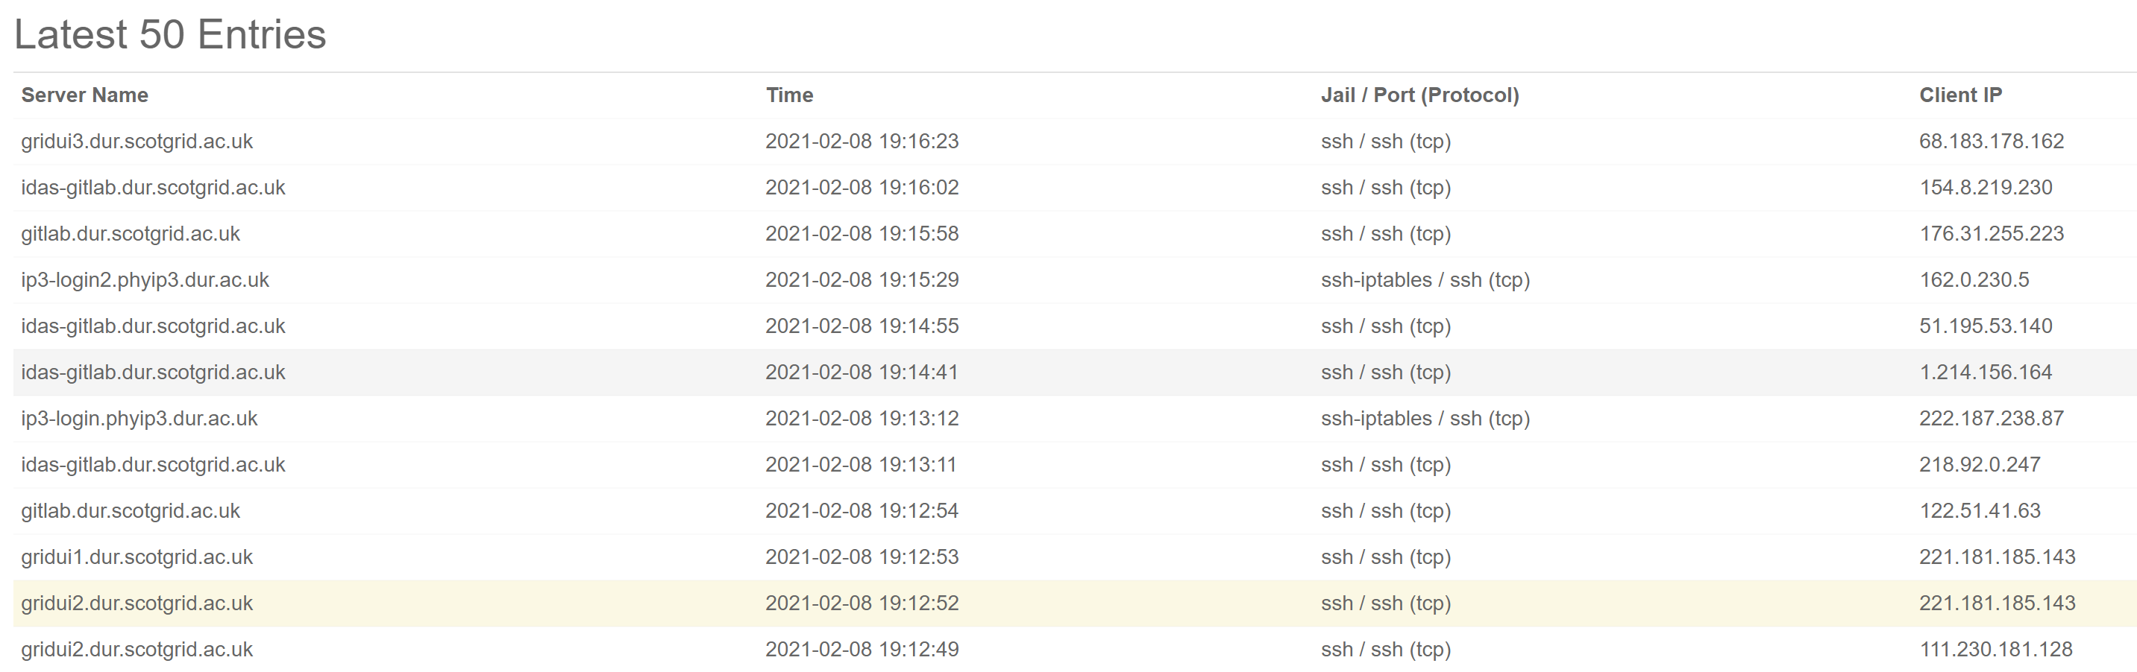
Ban Distribution

Slide 13
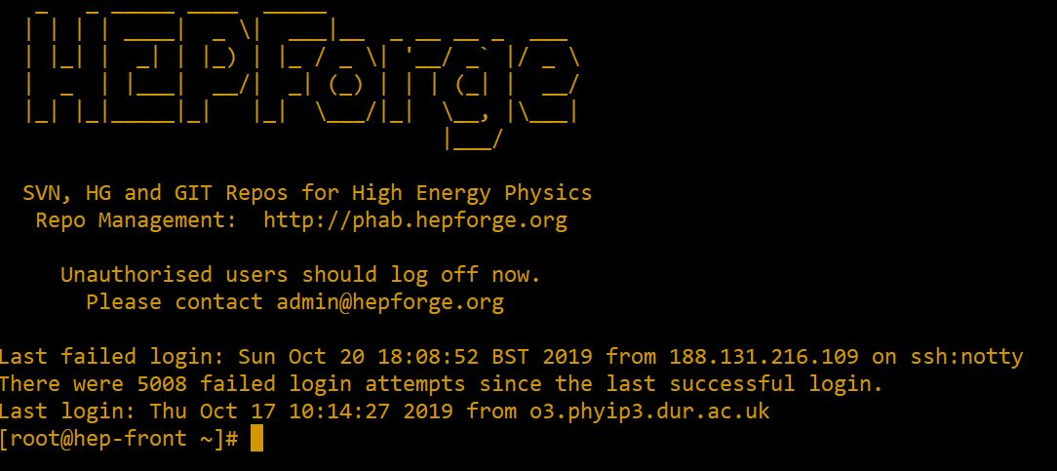
Without Shared-F2B
Hepforge.org – HEP software development platform hosted at Durham

Slide 14
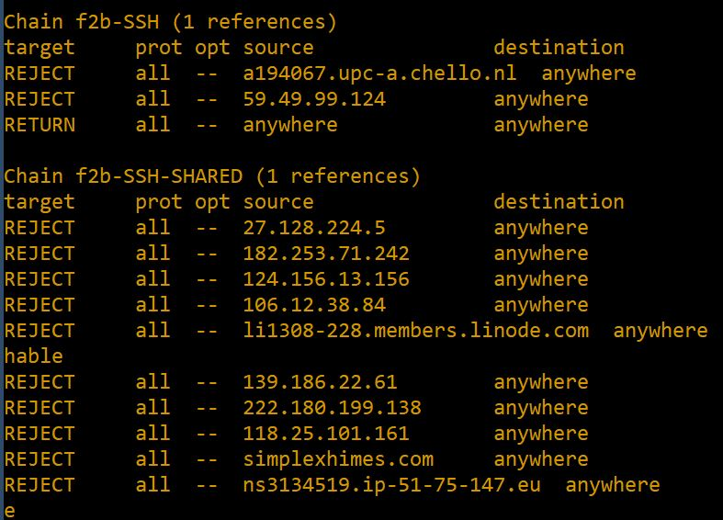
With Shared-F2B

Slide 15

Future Work
Implementation of SSH-honeypots to feed data into fail2ban
Encourage Broader Adoption across our local site
Ban everything….

Slide 16
Durham Shared Fail2Ban

